Slide 1
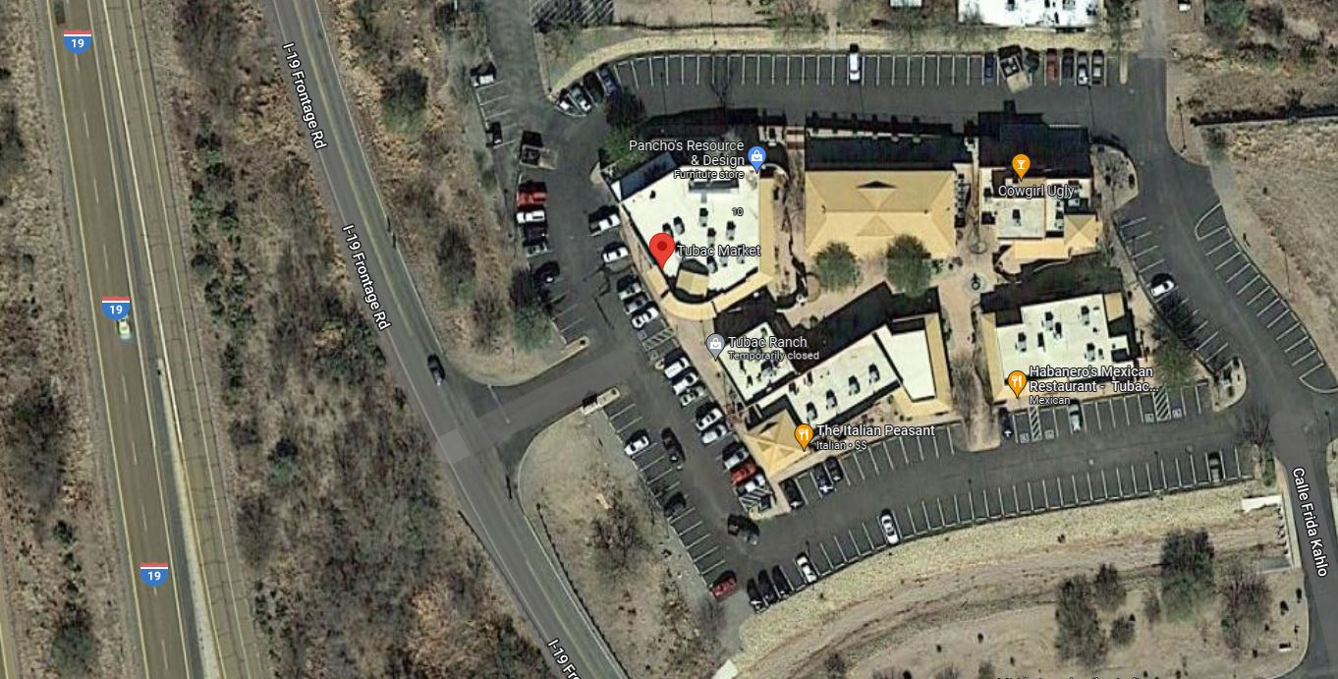
Lunch
Here
Enter Market Here

