Slide 1
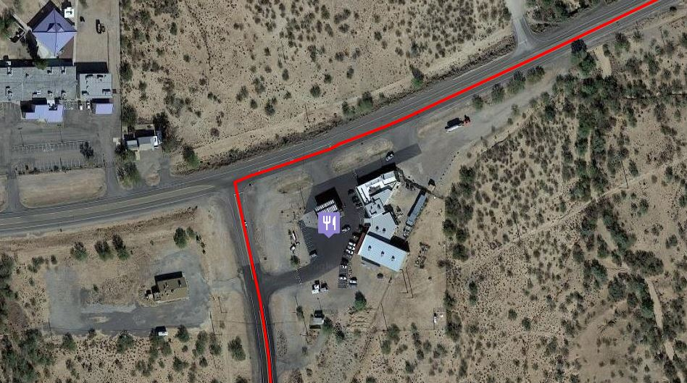
Your Route
Check In

