Slide 1
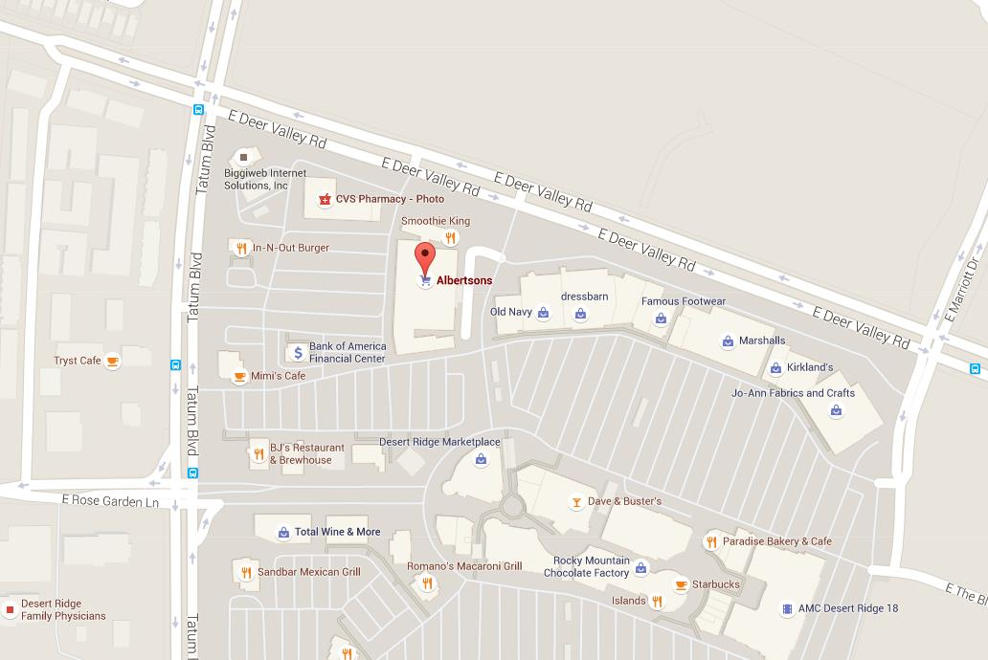
There’s a Starbucks inside Albertsons.
Make sure you come to the correct Starbucks.
Enter from Tatum Blvd or Deer Valley Rd.
Start Dir
Finish Dir
Park
Here

