Slide 1
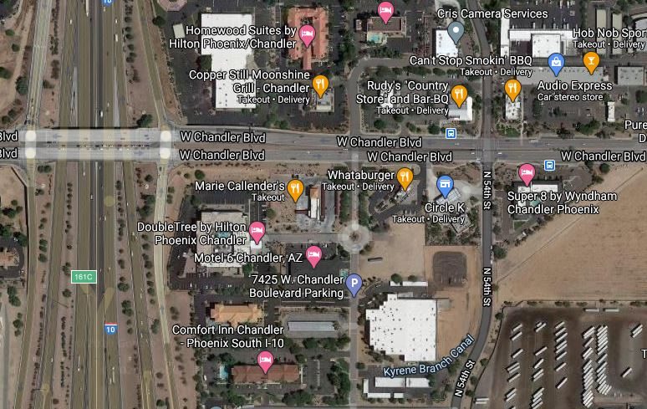
Car Wash
Whataburger
Park and
Start here

